Slide 1

Housing Prices in the United States
Data from 09/29/2021
Chinwe Oti

Slide 2
Problem Statement
According to a Gallup survey from April 2021:
71% of US adults expect prices to increase, up from 40% in 2020
The public is largely divided on whether it is a good time to buy a house
More people pick real estate as best investment than other options
10% of Americans down from 25% a year ago predict that home values will decrease

Slide 3
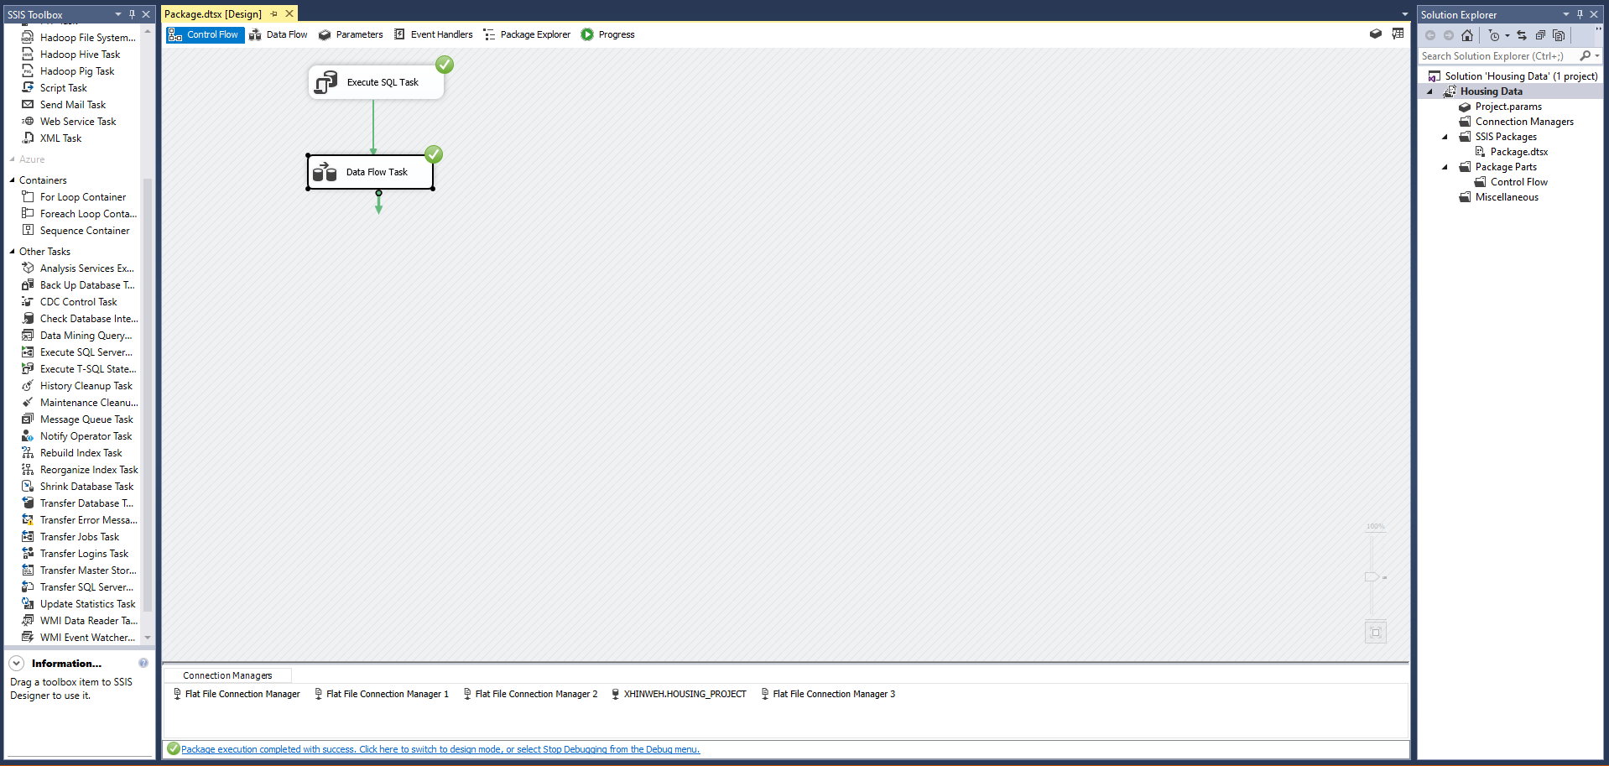
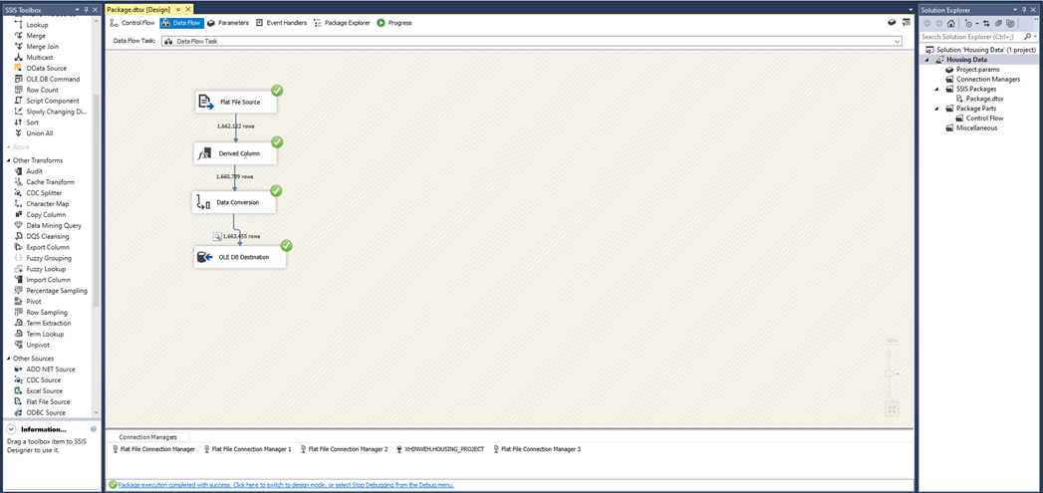
Extraction, Transformation, Loading (ETL)
Using Microsoft SQL Server Integration Services (SSIS)

Slide 4
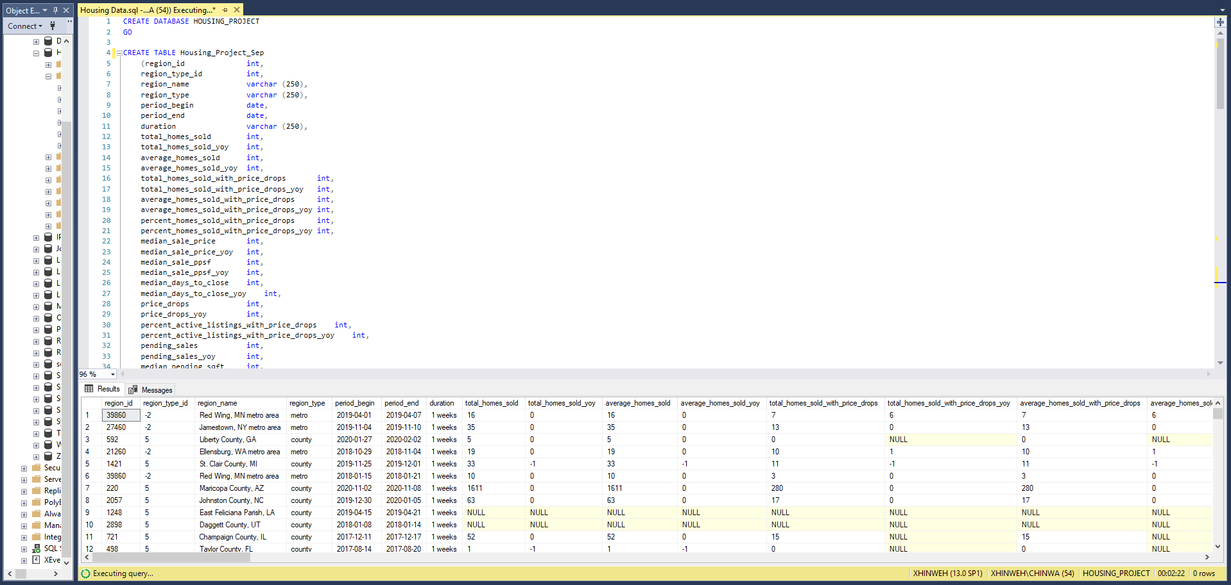
Database Loading
Microsoft SQL Server Management Studio

Slide 5

Key Performance Indicators
YoY Homes Sold | Number of homes sold in 2021 compared to 2020
YoY Median Sale Price | The cost of homes in 2021 compared to 2020
YoY Price Drop | Number of homes sold with price drops in 2021 compared to 2020
YoY New List Price | Comparable List price of homes in 2021 vs 2020
YoY Active Listing | Number of homes in Active listing in 2021 compared to 2020
MoM Days in the Market | Number of days homes are in the market in the current month compared to the previous month

Slide 6
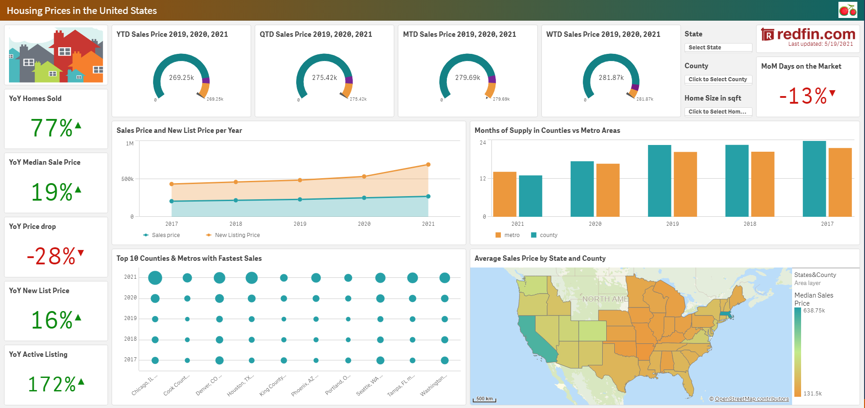
Dashboard Snapshot

Slide 7
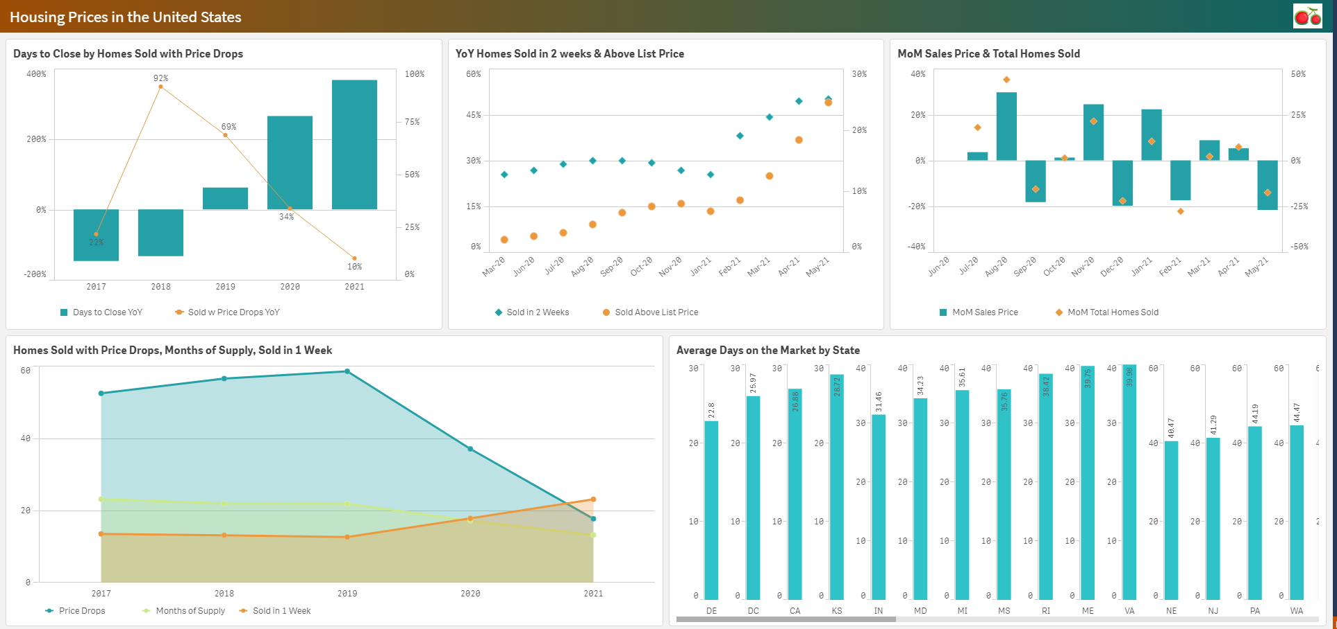
Dashboard Snapshot

Slide 8

Housing Prices in the United States

